Slide 1
Part-II Data Handling
Prof. K. Adisesha

Slide 2
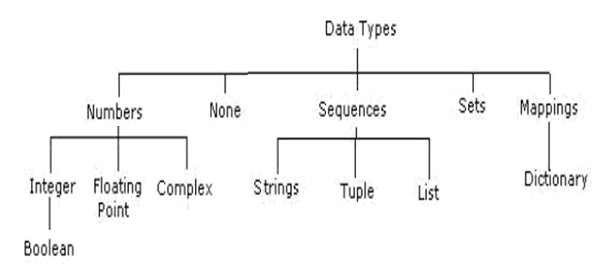
Data Types
Data Type specifies which type of value a variable can store. type() function is used to determine a variable 's type in Python.
Various data types supported by Python programs are:
Data Types In Python
1. Number
2. String
3. Boolean
4. List
5. Tuple
6. Dictionary

Slide 3
Data Types
Number In Python
It is used to store numeric values
Python has three numeric types:
Integers
Example: a = 10
2. Floating point numbers
Example: b = -101.4
3. Complex numbers
Example: b=complex(101,23)
Output :- (101+23j)

Slide 4
Data Types
String In Python
A string is a sequence of characters. In python we can create string using single(‘ ')or double quotes (“ "). Both are same in python.
Example
str='computer science'
print('str-',str) #print string
print('str[0]-',str[0]) #print first char
print('str[1:3]-,str[1:3]) #print string from position 1 to 3
Boolean In Python
It is used to store two possible values either true or false
Example
str="compsc"
b=str.isupper() #test if string contain uppercase
print(b)
Output
False

Slide 5
Data Types
List In Python
List are collections of items and each item has its own index value.
Tuple In Python
List and tuple, both are same except, a list is mutable python objects and tuple is immutable Python objects.
Immutable Python objects mean you can not modify the content so a tuple once it is assigned.
Example of List:
list=[6,9]
list[0]=55
print(list[0])
print(list[1])
OUTPUT
55, 9
Example of tuple
tup=(66,99)
Tup[0]=3 # error message will be displayed
print(tup[0])
print(tup[1])

Slide 6
Data Types
Dictionary In Python
It is an unordered collection of items and each item consist of a key and a value.
Example:
dict= {'Subject': 'comp sc', 'class': '11'}
print(dict)
print ("Subject : ", dict['Subject'])
print ("class : ", dict.get('class'))
Output
{'Subject': 'comp sc', 'class': '11'}
Subject : comp sc
class : 11

Slide 7
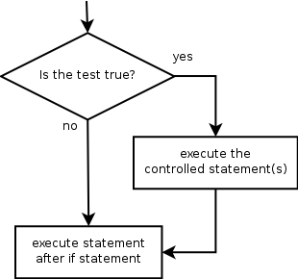
if Statement
if statement: Executes a group of statements only if a certain condition is true. Otherwise, the statements are skipped.
Syntax:
if condition:
statements
Example:
gpa = 3.4
if gpa > 2.0:
print "Your application is accepted."

Slide 8
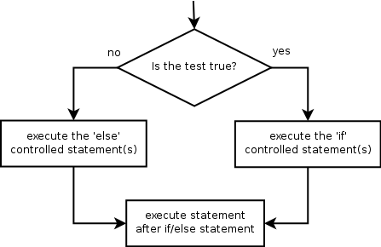
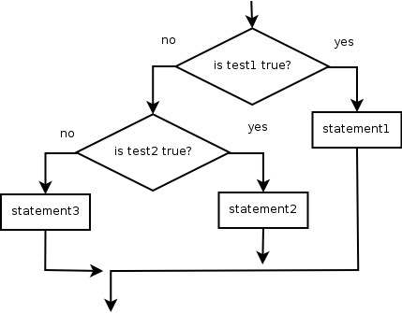
if/else
if/else statement: Executes one block of statements if a certain condition is True, and a second block of statements if it is False.
Syntax:
if condition:
statements
else:
statements
Example:
gpa = 1.4
if gpa > 2.0:
print "Welcome to University!"
else:
print "Your application is denied."
Multiple conditions can be chained with elif ("else if"):
if condition:
statements
elif condition:
statements
else:
statements

Slide 9
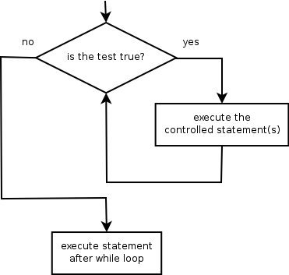
While Loop
while loop: Executes a group of statements as long as a condition is True.
good for indefinite loops (repeat an unknown number of times)
Syntax:
while condition:
statements
Example:
number = 1
while number < 200:
print number,
number = number * 2
Output:
1 2 4 8 16 32 64 128

Slide 10
The for loop
for loop: A for loop is used for iterating over a sequence (that is either a list, a tuple, a dictionary, a set, or a string).
Repeats a set of statements over a group of values.
Syntax:
for variableName in groupOfValues:
statements
We indent the statements to be repeated with tabs or spaces.
variableName gives a name to each value, so you can refer to it in the statements.
groupOfValues can be a range of integers, specified with the range function.
Example:
for x in range(1, 6):
print x, "squared is", x * x
Output:
1 squared is 1
2 squared is 4
3 squared is 9
4 squared is 16
5 squared is 25

Slide 11
range
The range function specifies a range of integers:
range(start, stop) - the integers between start (inclusive)
and stop (exclusive)
It can also accept a third value specifying the change between values.
range(start, stop, step) - the integers between start (inclusive)
and stop (exclusive) by step
Example:
for x in range(1, 10, 2):
print x
print "Blastoff!"
Output:
1 3 5 7 9
Blastoff!

Slide 12
The break & continue Statement
With the break statement we can stop the loop before it has looped through all the items
Example: Do not print banana
fruits = ["apple", "banana", "cherry"] for x in fruits: if x == "banana": break print(x)
Output: apple
Example: Exit loop when x is “banana”
fruits = ["apple", "banana", "cherry"] for x in fruits:
print(x) if x == "banana": break
Output:
apple banana
With the continue statement we can stop the current iteration of the loop, and continue with the next
Example: Do not print banana
fruits = ["apple", "banana", "cherry"] for x in fruits: if x == "banana": continue print(x)
Output: apple cherry

